Slide 1

“CROWDFUNDING”
GROUP -01
Name Of Group Members :-
Ms.Alisha Khan
Ms. Pooja Dolai
Mrs. Ankita Chaugule
Mr. Shreenidhi M M
Mr.Saiprasad Hadolikar
Mr. Ajay Chavan

Slide 2
INTRODUCTION
Crowdfunding Kickstarter
Domain – Finance.
Datasets: Crowdfunding_projects_1,Crowfunding_Category,Crowdfunding_Creator,Crowdfunding_Location.
Project work done on Excel , My SQL , Power BI & Tableau.
Kickstarter is a crowdfunding platform that allows individuals, entrepreneurs, and creatives to raise funds for various projects and idea
The concept behind Kickstarter is creators propose a project and set a funding goal they need to reach within a specified timeframe. Supporters, or "backers," can pledge money to support the project. If the funding goal is met by the end of the campaign, the project is considered successful, and the backers' credit cards are charged. If the funding goal is not met, no money is collected from the backers.
Goal is to analyze the data in order to get clarity to invest or raise funds for the successful projects based on category, location and so on.

Slide 3
OBJECTIVE
The main objective of Crowdfunding Project is to propose a project , analyse key factors influencing Success rate by implementing measures and market saturation , and create informative visualizations to present findings effectively.
By utilizing Excel, Power BI, My SQL, and Tableau, we can streamline data processing, generate insights, and build interactive dashboards for a comprehensive analysis.
These objectives will guide us in leveraging the tools efficiently to achieve a thorough understanding of the data.
By achieving these objectives, the Crowdfunding Project aims to enhance the Market Saturation, Backer Fatigue, profitability, and Campaign Effectiveness while effectively managing credit risk and ensuring regulatory compliance.

Slide 4
STRATEGY
Introduce personalized recommendations and engagement initiatives to combat backer fatigue and increase user retention.
Diversify revenue streams and establish contingency plans to mitigate the impact of economic fluctuations
Stay abreast of regulatory changes and compliance requirements to operate effectively in different markets.
Conduct market research and localization efforts to tailor strategies for successful international expansion and market penetration.

Slide 5
FRAMEWORK
DATA CLEANING & PROCESSING
DASHBOARD REFINEMENT
INTEGRATION
CONSOLIDATION
KPI’S

Slide 6
Total Number of Projects based on Outcome, Location, Category.
01
Total Number of Projects created by Year , Quarter , Month.
02
Successful Projects Amount Raised ,Number of Backers, Average number of Days for successful projects.
03
KPI’S
Top Successful Projects based on Number of Backers and Amount Raised.
04
05
Percentage of Successful Projects Overall, Category, Year, Month, Goal Range

Slide 7
OVERVIEW OF DASHBOARD
Total Projects and Successful Projects: The dashboard shows that there have been a total of 365.89K projects, out of which 140.31K have been successful. This gives a quick overview of the overall activity and success rate.
Amount Raised and Average Number of Days: The total amount raised by all projects is $16,040.67M, and the average number of days for successful projects is 81.43. These figures provide insights into the financial impact of the projects and the time frame for successful projects.
Top Successful Projects by Amount Raised and Number of Backers: The bar charts display the top successful projects, ranking them by the amount of money they raised and the number of backers they attracted. This highlights the most impactful projects in terms of financial support and community engagement.
Total Number of Projects by Year: A line chart shows the number of projects created each year, indicating trends over time. There is a noticeable peak in 2015, followed by a decline.
Total Number of Projects by Location: This bar chart ranks countries by the number of projects they have launched, with the United States being the most active location.

Slide 8
OVERVIEW OF DASHBOARD
Total Number of Projects by Outcome: A donut chart categorizes projects by their final status, such as successful, canceled, or failed, providing a clear visual representation of the distribution of outcomes.
Total Number of Projects by Category: Another bar chart shows the number of projects in each category, with Product Design, Tabletop Games, and Music being the top categories.
Percentage of Successful Projects Over Time: A line chart depicts the success rate of projects over the years, showing how it has fluctuated.
Percentage of Successful Projects by Category: This bar chart compares the success rates across different categories, with Tabletop Games and Product Design having the highest success rates.
Percentage of Successful Projects Created by Month: The bar chart shows which months have the highest percentage of successful project launches, with March being the most successful.
Percentage of Successful Projects by Goal Range: A stacked bar chart breaks down the success rates by different funding goal ranges, providing insight into which goal ranges tend to have higher success rates.

Slide 9
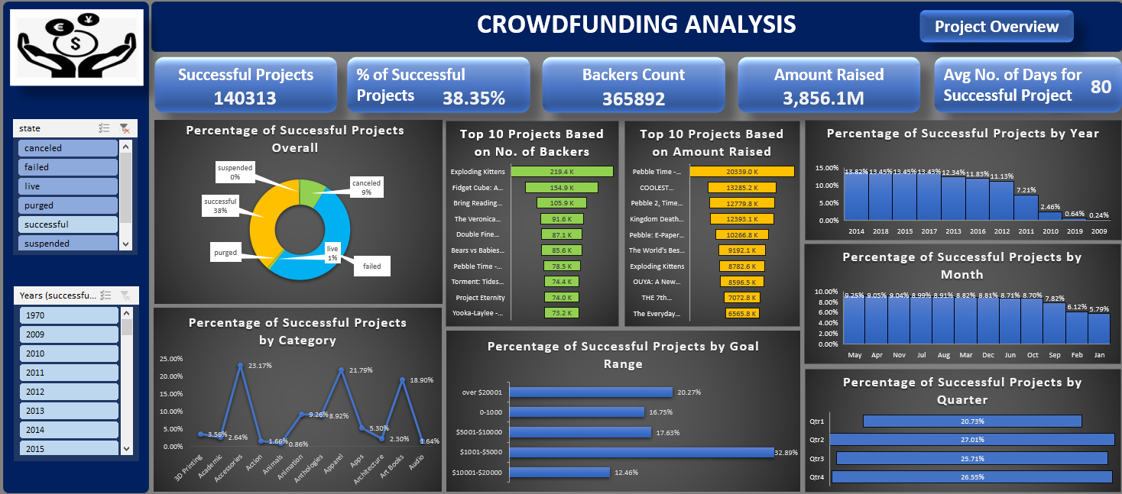
EXCEL DASHBOARD-1

Slide 10
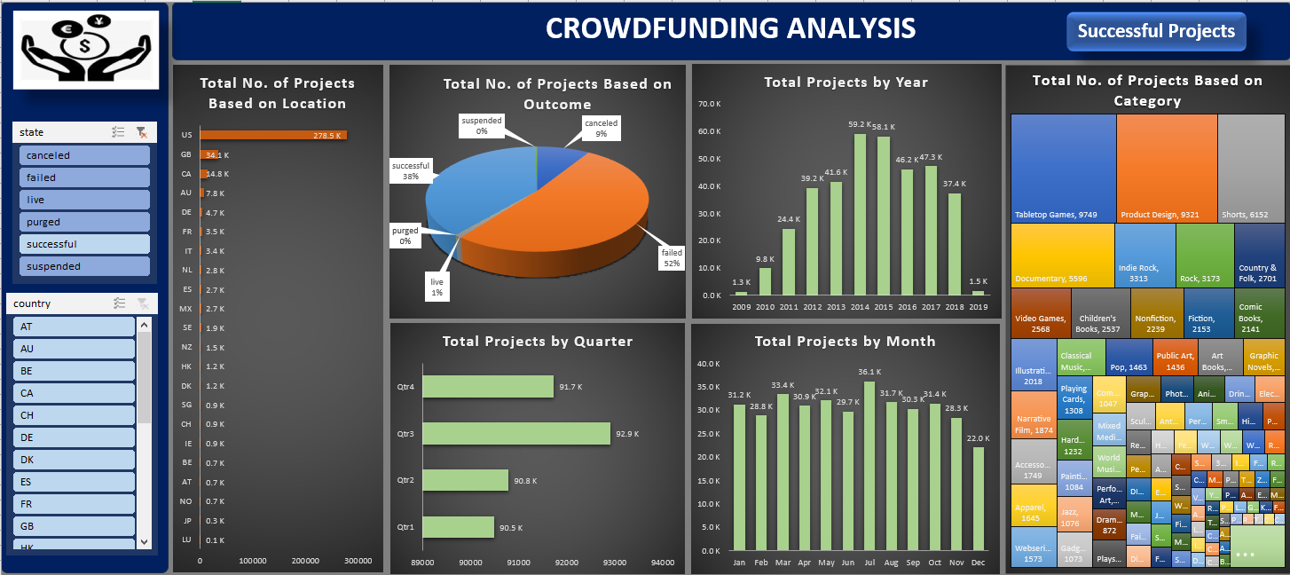
EXCEL DASHBOARD-2

Slide 11
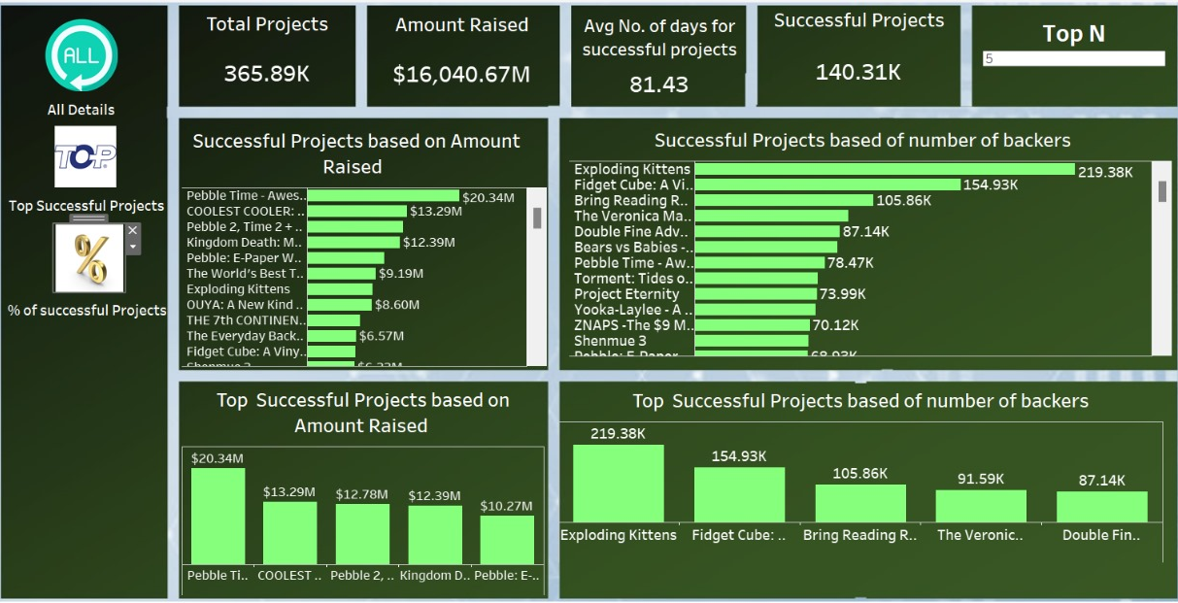
TABLEAU DASHBOARD-1

Slide 12
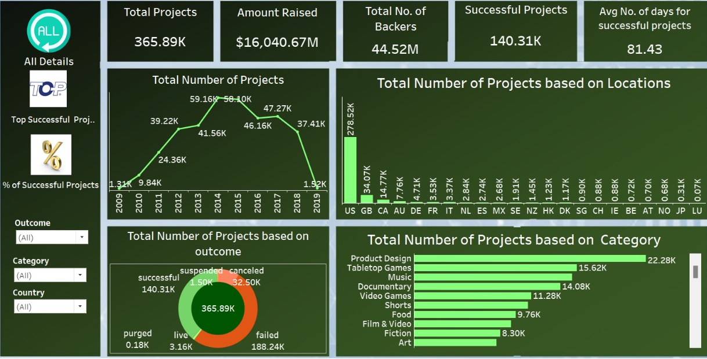
TABLEAU DASHBOARD-2

Slide 13
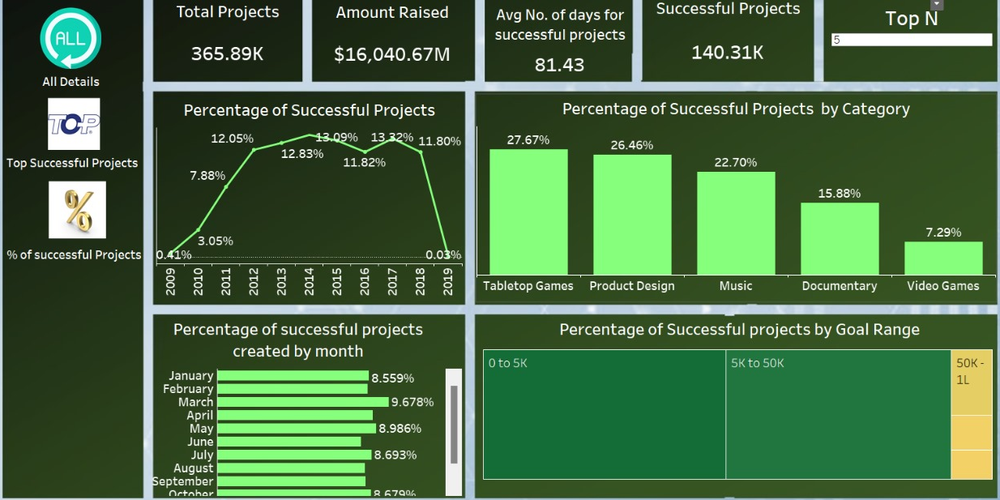
TABLEAU DASHBOARD-3

Slide 14
FRAMEWORK FOR SQL
The project file contains the 'created_at' timestamp in epoch time which we converted into human-readable format
Cleaning of Data as per KPI’S
Imported 4 tables in Workbench
Executed using required syntax as per KPI’S

Slide 15
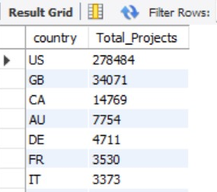
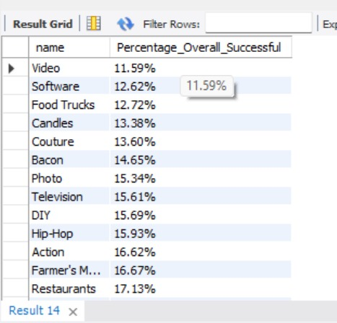
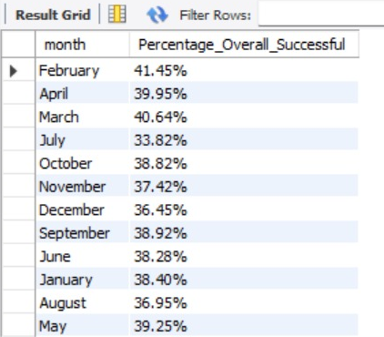
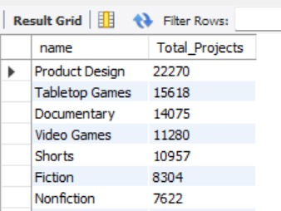
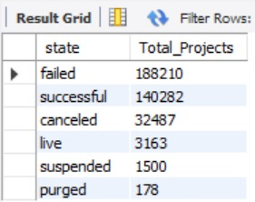
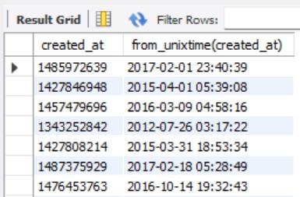

Slide 16
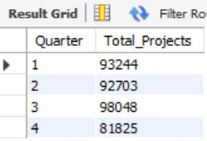
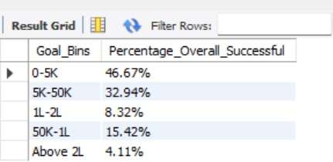
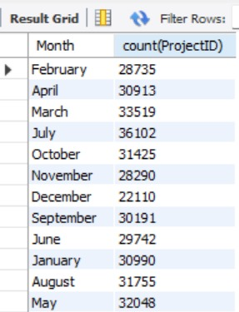
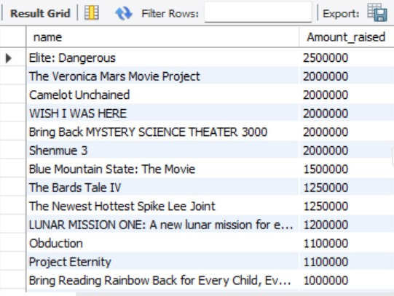

Slide 17
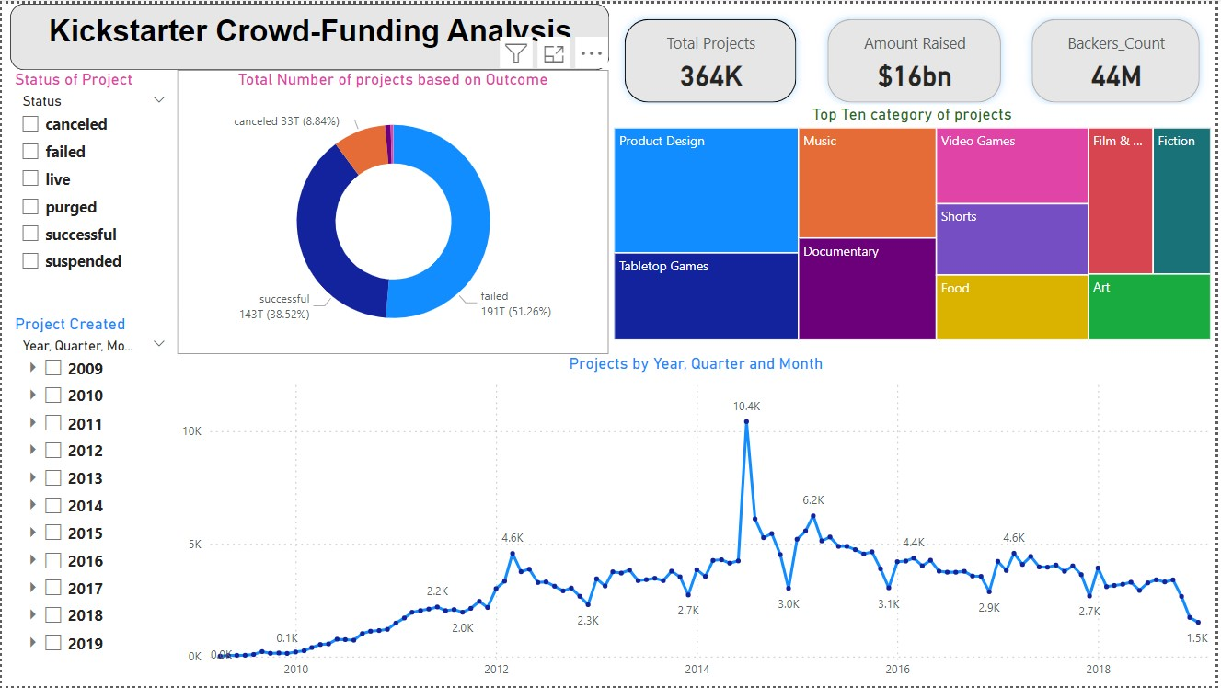
POWER BI DASHBOARD-1

Slide 18
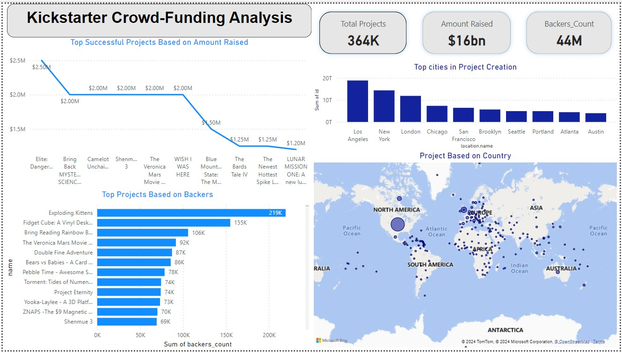
POWER BI DASHBOARD-2

Slide 19
INSIGHTS FROM THE ANALYSIS:
The data collected is from April 2009 to January 2019 the total number of projects created is 365892 from this successful was 140313 with the success rate of 38.35%.
The successful projects amount pledged is 3,47,94,7,765 USD by 3,99,65,853 numbers of backers within Average number of day is 80.
Each backer has invested average of 8.7 USD for the successful projects.
Top category is music category with the success rate 17.69%.
Top Successful projects based on number of backers is "Exploding Kittens" and by amount pledged is "Coolest cooler: 21st century cooler that's actually cooler“.
The goal range between 0-9999 has highest success rate with 61.89% which means backers are interested in investing small goal amount.
The maximum success projects was created in 2014 with 19260 from 59155 with success rate of 13.73%.
The United States has successful projects with count of 110336.

Slide 20
CONCLUSION
In conclusion, the data analysis reveals a robust crowdfunding ecosystem with a significant number of projects achieving success:
Project Volume & Success: 365.89K projects, 140.31K successful
Financial Impact: $16B raised collectively
Backer Engagement: Top project had 219K backers
Temporal Trends: Peak in 2015, decline since
Geographical Distribution: US leads in projects
Outcome Distribution: Mostly successful or failed
Category Popularity & Success: Product Design & Tabletop Games top
Seasonal Variation: March most successful month
Goal Range Success: Varies by funding goal range
A high volume of projects with over $16 billion raised, indicating strong market activity.
There is a notable peak in project launches in 2015, with a subsequent decline.
Harness the power of Excel for data organization, SQL for advanced querying, and leverage Power BI and Tableau for dynamic visualizations. Utilize KPIs to create comprehensive dashboards that enhance decision-making and optimize lending operations.

Slide 21
Thank you

